Slide 1
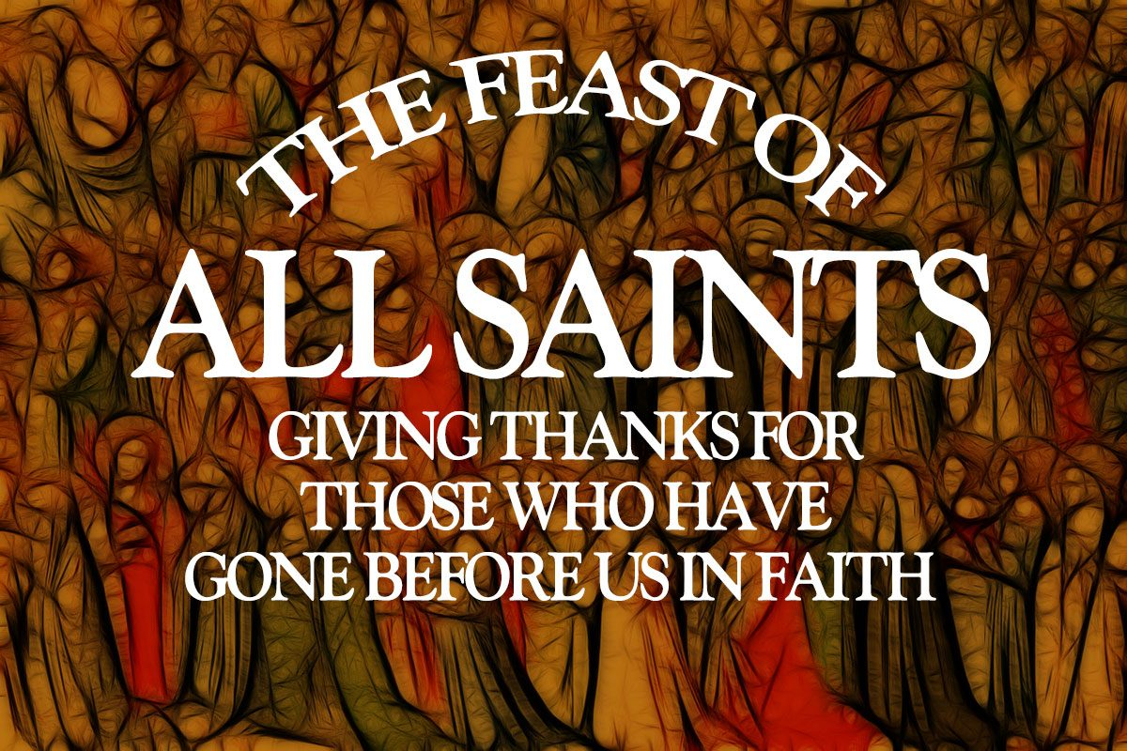

Slide 2
We stand to sing
Gathering Hymn #232
For All The Saints

Slide 3
For all the saints,
who from their labours rest,
Who thee by faith
before the world confessed,
Thy name, O Jesus, be forever blest.
Alleluia, alleluia!

Slide 4
Thou wast their rock,
their fortress, and their might:
Thou, Lord, their Captain
in the well-fought fight,
Thou, in the darkness,
still their one true light.
Alleluia, alleluia!

Slide 5
The golden evening
brightens in the west;
Soon, soon to faithful
warriors comes their rest:
Sweet is the calm
of paradise the blest.
Alleluia, alleluia!

Slide 6
But lo, there breaks
a yet more glorious day;
The saints triumphant
rise in bright array:
The King of Glory
passes on his way.
Alleluia, alleluia!

Slide 7
From earth's wide bounds,
from ocean's farthest coast,
Through gates of pearl
streams in the countless host,
Singing to Father,
Son and Holy Ghost.
Alleluia, alleluia!

Slide 8
Gathering
In the name of the Father,
and of the Son,
and of the Holy Spirit.
All Amen.

Slide 9
Words of Welcome
Grace, mercy and peace
from God our Father
and the Lord Jesus Christ
be with you
All and also with you.

Slide 10
Prayers of Penitence
God the Father forgives us in Christ and heals us by the Holy Spirit.
Let us therefore put away all anger and bitterness, all slander and malice,
and confess our sins
to God our redeemer.

Slide 11
All Most merciful God,
Father of our Lord Jesus Christ,
we confess that we have sinned
in thought, word and deed.
We have not loved you with our whole heart.
We have not loved our neighbours as ourselves.

Slide 12
In your mercy
forgive what we have been,
help us to amend what we are,
and direct what we shall be;
that we may do justly,
love mercy,
and walk humbly with you, our God.
Amen.

Slide 13
Lord, have mercy.
All Lord, have mercy.
Christ, have mercy.
All Christ, have mercy.
Lord, have mercy.
All Lord, have mercy.

Slide 14
Absolution
Almighty God, who forgives all who truly repent,
have mercy upon you,
pardon and deliver you from all your sins,
confirm and strengthen you in all goodness,
and keep you in life eternal;
through Jesus Christ our Lord.
All Amen.

Slide 15
Gloria (Raemoir version)
We sing together
All Glory to God in the highest,
and peace to his people on earth.
Lord God, heavenly King,

Slide 16
almighty God and Father,
we worship you, we give you thanks,
we praise you for your glory.
(music break)
Lord Jesus Christ, only Son of the Father,
Lord God, Lamb of God,

Slide 17
you take away the sin of the world,
have mer—cy on us;
you are seated at the right hand of the Fa—ther
receive our prayer.
(music break)

Slide 18
For you alone are the Ho—ly One,
you alone are the Lord,
you alone are the Most High,
Je—sus Christ,
with the Ho—ly Spirit,

Slide 19

in the glory of God the Fa—ther.
A—men, A—men.
Let us pray

Slide 20
Collect Prayer
God of holiness,
your glory is proclaimed in every age:
as we rejoice in the faith of your saints,
inspire us to follow their example
with boldness and joy;
through Jesus Christ our Lord. All Amen.

Slide 21
The Liturgy of the Word
Old Testament – Daniel 7: 1-3 &15-18
In the first year of Belshazzar king of Babylon, Daniel had a dream, and visions passed through his mind as he was lying in bed. He wrote down the substance of his dream.

Slide 22
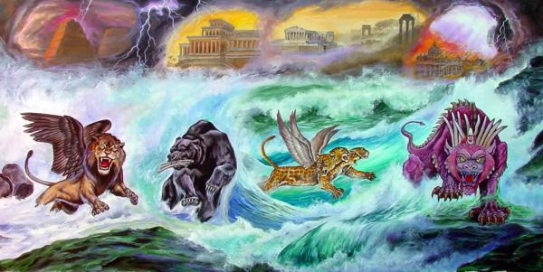
Daniel said: “In my vision at night I looked, and there before me were the four winds of heaven churning up the great sea. Four great beasts, each different from the others, came up out of the sea.
I, Daniel, was troubled in spirit, and the visions that passed through my mind disturbed me.

Slide 23
I approached one of those standing there and asked him the meaning of all this. So he told me and gave me the interpretation of these things: ‘The four great beasts are four kings that will rise from the earth. But the holy people of the Most High will receive the kingdom and will possess it forever—yes, for ever and ever.’
This is the word of the Lord
All: Thanks be to God

Slide 24
Psalm 149
Response sung by choir then sung by all.
“Sing, O sing to the Lord a new song.
Praise the Lord”

Slide 25
New Testament - Ephesians 1:15-23
Ever since I heard about your faith in the Lord Jesus and your love for all God’s people, I have not stopped giving thanks for you, remembering you in my prayers. I keep asking that the God of our Lord Jesus Christ, the glorious Father, may give you the Spirit of wisdom and revelation, so that you may know him better.

Slide 26
I pray that the eyes of your heart may be enlightened in order that you may know the hope to which he has called you, the riches of his glorious inheritance in his holy people, and his incomparably great power for us who believe. That power is the same as the mighty strength he exerted when he raised Christ from the dead and seated him at his right hand in the heavenly realms, far above all rule and authority

Slide 27
power and dominion, and every name that is invoked, not only in the present age but also in the one to come.
And God placed all things under his feet and appointed him to be head over everything for the church, which is his body, the fullness of him who fills everything in every way.
This is the word of the Lord
All Thanks be to God

Slide 28
Gospel - We stand to hear the Gospel
Glory to the Father, and to the Son,
and to the Holy Spirit,
one God, who was, and who is,
and who is to come, the Almighty.
All: Alleluia, Alleluia, Alleluia x2

Slide 29
Gospel Greeting
Hear the Gospel of our Lord
according to Luke 6:20-31
All: Glory to you, O Lord. +

Slide 30
Looking at his disciples, he said:
Blessed are you who are poor, for yours is the kingdom of God. Blessed are you who hunger now, for you will be satisfied. Blessed are you who weep now, for you will laugh. Blessed are you when people hate you, when they exclude you and insult you

Slide 31
and reject your name as evil, because of the Son of Man.
Rejoice in that day and leap for joy, because great is your reward in heaven. For that is how their ancestors treated the prophets.
But woe to you who are rich, for you have already received your comfort. Woe to you who are well fed now, for you will go hungry.

Slide 32
Woe to you who laugh now, for you will mourn and weep. Woe to you when everyone speaks well of you, for that is how their ancestors treated the
false prophets.
This is the Gospel of the Lord
All: Praise to you O Christ

Slide 33
Sermon

Slide 34
Creed
We stand to affirm our Faith
All We believe in one God,
the Father, the Almighty,
maker of heaven and earth,
of all that is,
seen and unseen.

Slide 35
We believe in one Lord, Jesus Christ,
the only Son of God,
eternally begotten of the Father,
God from God, Light from Light,
true God from true God,
begotten, not made,
of one Being with the Father;
through him all things were made.

Slide 36
For us and for our salvation
he came down from heaven,
was incarnate from the Holy Spirit and the Virgin Mary and was made man.
For our sake he was crucified
under Pontius Pilate;
he suffered death and was buried.

Slide 37
On the third day he rose again
in accordance with the Scriptures;
he ascended into heaven
and is seated at the right hand of the Father.
He will come again in glory to judge the living and the dead,
and his kingdom will have no end.

Slide 38
We believe in the Holy Spirit,
the Lord, the giver of life,
who proceeds from the Father and the Son,
who with the Father and the Son
is worshipped and glorified,
who has spoken through the prophets.

Slide 39
We believe in one holy catholic
and apostolic Church.
We acknowledge one baptism for the forgiveness of sins.
We look for the resurrection of the dead,
and the life of the world to come.
Amen.

Slide 40

God of Mission,
who alone brings growth
to your church, send your Holy Spirit
To give Vision to our planning,
Wisdom to our Actions,
and Power to our Witness.
Help our church to grow in numbers,
in Spiritual Commitment to You,
And in Service to our local Community.
Through Jesus Christ our Lord. Amen.
The prayer
for

Slide 41

Prayers of Intercession
And at the end
Merciful Father,
All: accept these prayers
for the sake of your Son,
our Saviour Jesus Christ.
Amen.

Slide 42
The Peace
Peace to you from God our heavenly Father.
Peace from his Son Jesus Christ who is our peace.
Peace from the Holy Spirit, the life-giver.
The peace of the triune God be always with you
All : and also with you.
Let us offer one another a sign of peace.

Slide 43
We sing together
Offertory Hymn #227
Rejoice in God’s Saints

Slide 44
Rejoice in God’s saints,
today and all days!
A world without saints
forgets how to praise.
Their faith in acquiring
the habit of prayer,
their depth of adoring,
Lord, help us to share.
We stand to sing

Slide 45
Some march with events
to turn them God’s way;
some need to withdraw,
the better to pray;
some carry the gospel
through fire and through flood:
our world is their parish;
their purpose is God.
We stand to sing

Slide 46
Rejoice in those saints,
unpraised and unknown,
who bear someone’s cross,
or shoulder their own;
they shame our complaining,
our comforts, our cares:
what patience in caring,
what courage, is theirs!
We stand to sing

Slide 47
Rejoice in God’s saints,
today and all days:
a world without saints
forgets how to praise.
In loving, in living,
they prove it is true :
the way of self-giving,
Lord, leads us to you.
We stand to sing

Slide 48
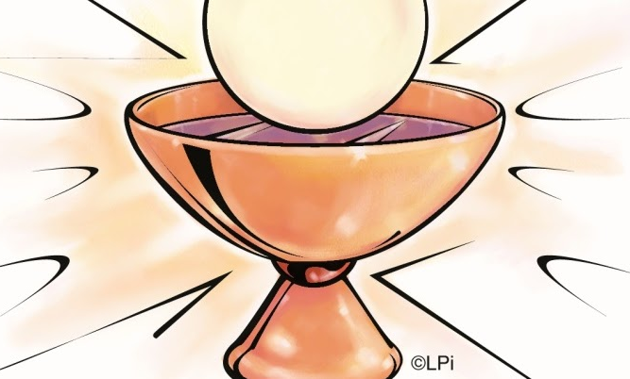
Eucharistic Prayer H
The Lord is here.
All His Spirit is with us.
Lift up your hearts.
All We lift them to the Lord.
Let us give thanks to the Lord our God.
All It is right to give thanks and praise.

Slide 49
It is right to praise you, Father, Lord of all creation;
in your love you made us for yourself.
When we turned away
you did not reject us,
but came to meet us in your Son.
All You embraced us as your children
and welcomed us to sit and eat with you.

Slide 50
In Christ you shared our life
that we might live in him and he in us.
All He opened his arms of love upon the cross
and made for all the perfect sacrifice for sin.
On the night he was betrayed,
at supper with his friends
he took bread, and gave you thanks;
he broke it and gave it to them, saying:

Slide 51
Take, eat; this is my body which is given for you;
do this in remembrance of me.
All Father, we do this in remembrance of him:
his body is the bread of life.
At the end of supper, taking the cup of wine,
he gave you thanks, and said:

Slide 52
Drink this, all of you; this is my blood of
the new covenant,
which is shed for you for the forgiveness of sins;
do this in remembrance of me.
All Father, we do this in remembrance of him:
his blood is shed for all.

Slide 53
As we proclaim his death and celebrate his
rising in glory,
send your Holy Spirit that this bread and this wine
may be to us the body and blood of your dear Son.
All As we eat and drink these holy gifts
make us one in Christ, our risen Lord.

Slide 54
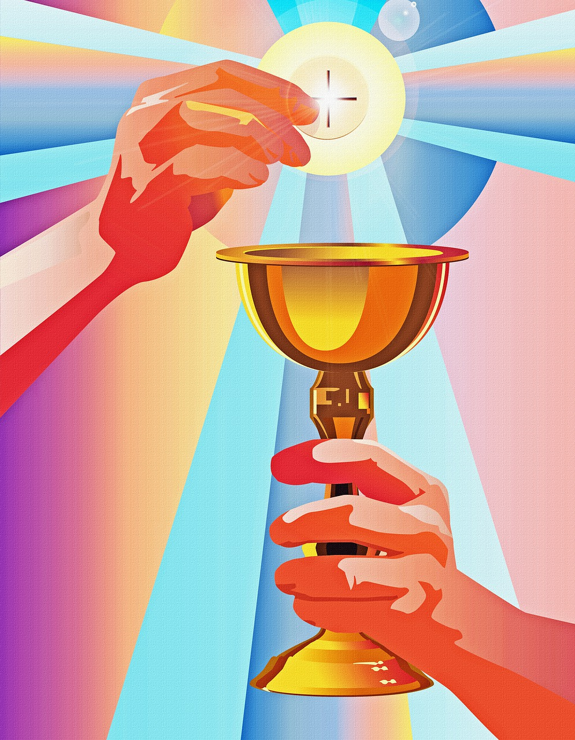
With your whole Church
throughout the world
we offer you this sacrifice
of praise and lift our
voice to join the eternal
song of heaven:

Slide 55
Sanctus (Holy holy) ()
We sing together
All Holy, holy, holy Lord, God of power and might, heaven and earth are full of your glory. Hosanna in the highest, highest, Hosanna in the highest.
Blessed is he who comes in the name of the Lord. Hosanna in the highest, highest.
Hosanna in the highest, the highest, the highest,
the highest.

Slide 56
The Lord’s Prayer
As our Saviour taught us, so we pray
All Our Father, who art in heaven, hallowed be thy name; thy kingdom come; thy will be done; on earth as it is in heaven. Give us this day our daily bread.

Slide 57
And forgive us our trespasses, as we forgive those who trespass against us.
And lead us not into temptation; but deliver us from evil. For thine is the kingdom, the power and the glory, for ever and ever. Amen.

Slide 58
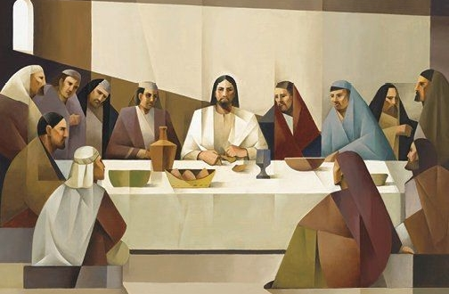
Breaking of the Bread
Minister breaks
the consecrated bread.
We break this bread
to share in the body of Christ.
All Though we are many,
we are one body,
because we all share in one bread.

Slide 59
Lamb of God
All Lamb of God, you take away the sins of the world, have mercy on us.
Lamb of God, you take away the sin of the world, have mercy on us.
Lamb of God, you take away the sin of the world, grant us peace.
Congregation Kneels

Slide 60
Jesus is the Lamb of God
who takes away the sin of the world.
Blessed are those who are called to his supper.
All Lord, I am not worthy to receive you,
but only say the word,
and I shall be healed.

Slide 61
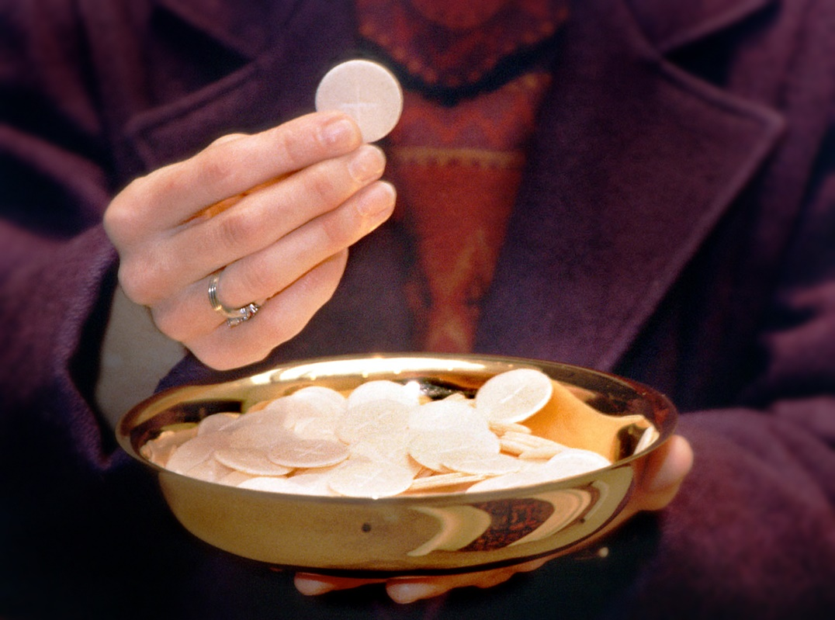
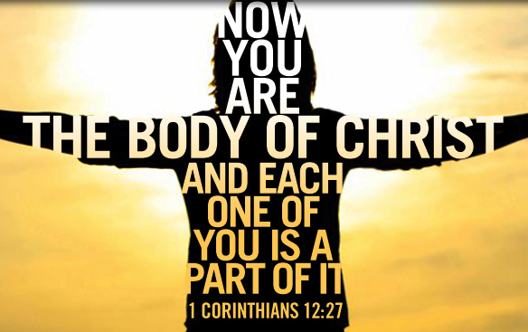
Distribution of Communion

Slide 62
We sing togetherto sing
Communion Hymn 136
Alleluia, Alleluia,
Give Thanks to the Risen Lord

Slide 63
Alleluia, alleluia,
give thanks to the risen Lord
Alleluia, alleluia,
give praise to his name.
Jesus is Lord of all the earth.
He is the King of creation.
We stand to sing

Slide 64
Alleluia, alleluia,
give thanks to the risen Lord
Alleluia, alleluia,
give praise to his name.
We stand to sing
Spread the good news o'er all the earth:
Jesus has died and is risen:

Slide 65
Alleluia, alleluia,
give thanks to the risen Lord
Alleluia, alleluia,
give praise to his name.
We stand to sing
We have been crucified with Christ:
now we shall live for ever.

Slide 66
Alleluia, alleluia,
give thanks to the risen Lord
Alleluia, alleluia,
give praise to his name.
We stand to sing
God has proclaimed the just reward:
life for all men, alleluia

Slide 67
Alleluia, alleluia,
give thanks to the risen Lord
Alleluia, alleluia,
give praise to his name.
We stand to sing
Come, let us praise the living Lord,
Joyfully sing to our Saviour.
(Repeat Chorus) Alleluia, alleluia…..

Slide 68
Prayer after Communion
Almighty God,
we thank you for feeding us with the body and blood of your Son Jesus Christ.
Through him we offer you our souls and bodies to be a living sacrifice.
Send us out in the power of your Spirit
to live and work to your praise and glory.
All Amen

Slide 69
Post Communion Collect
God, the source of all holiness
and giver of all good things:
may we who have shared at this table as strangers and pilgrims here on earth
be welcomed with all your saints
to the heavenly feast on the day of your kingdom; through Jesus Christ our Lord.
All: Amen

Slide 70



Slide 71
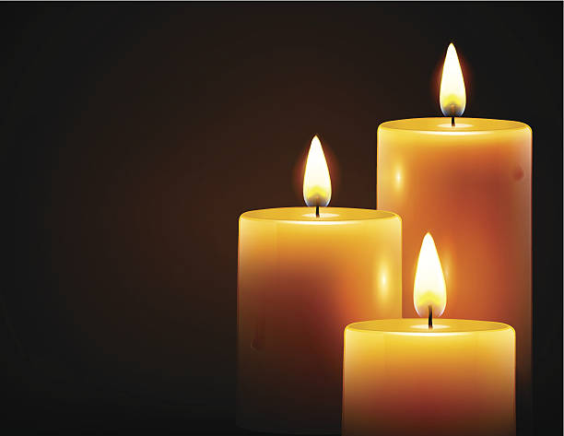

A time of Remembering
those who have Died
All Soul’s Day Service
Wed 2nd Nov 7pm
All Soul’s Day Service
Wed 2nd Nov 7pm
The souls of the righteous
are in the hand of God
Wisdom 3:1
The souls of the righteous
are in the hand of God
Wisdom 3:1

Slide 72




SATURDAY 3RD DECEMBER
Volunteers to man stalls and Prize Donations wanted please!

Slide 73
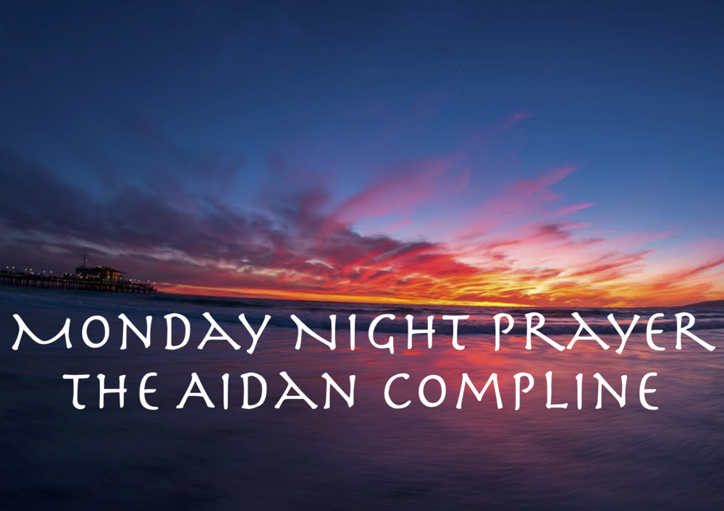
JOIN US AT 7PM
In the Lady Chapel

Slide 74
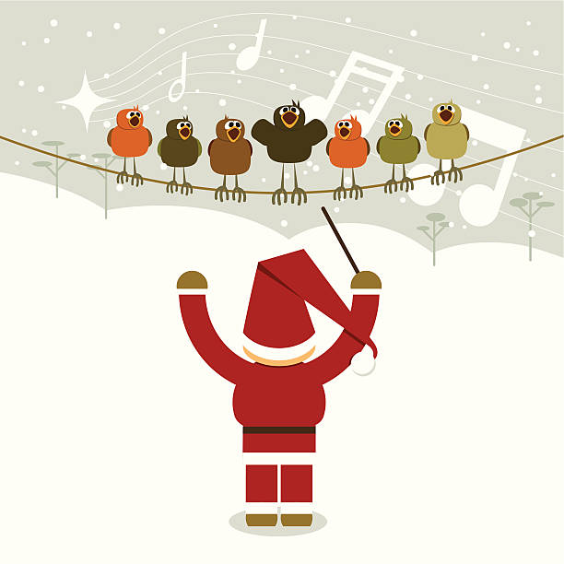




Christmas
Choir
Practice
Tuesdays
at 7pm

Slide 75

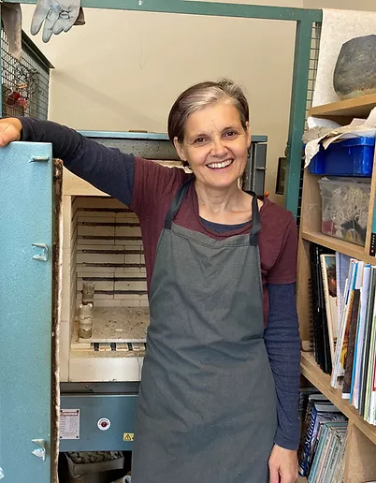
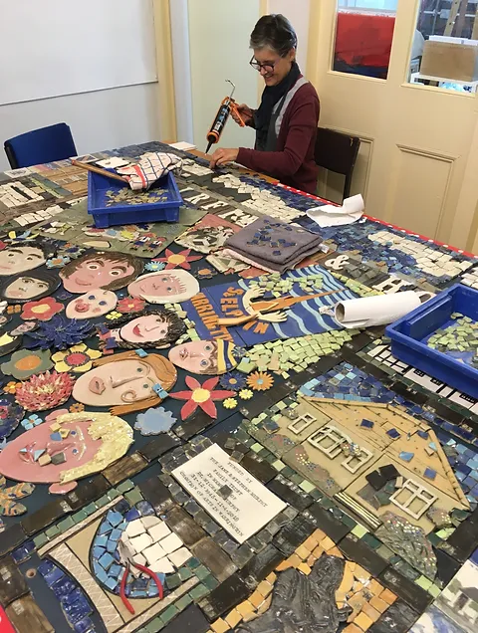
WELCOME
to
Debbie Podmore
*
Ceramics Artist

Slide 76

Next Course Starting
Wed Jan 18th
St Luke’s Church,Crosby
Directions offers teaching, group discussions, personal reflection, and focused exploration over 12 sessions.
lucy.blakeman@liverpool.anglican.org

Slide 77
Final Blessing
May the love of the Father, the tenderness of the Son, and the presence of the Spirit, gladden your heart and bring peace to your soul, this day and every day!
All Amen.

Slide 78

The Dismissal
Minister dismisses the people
Go in peace to love
and serve the Lord
All In the name of
Christ. Amen.

Slide 79
We stand to sing
Exit Hymn
A Faith That Lives

Slide 80
A faith that lives, Lord grant to us this day.
A faith that springs to life from love divine,
A faith that's nurtured by Christ's living word,
And strengthened by his gifts
of bread and wine.

Slide 81
The saints and martyrs teach us how to live;
To fix our eyes on God and seek his ways,
To follow closely where they first have led,
And finding Christ, to serve him all our days.

Slide 82
Not by great deeds, nor martyrdoms alone,
But by each sacrifice of love and care,
By work well done, discomfort gladly borne,
By ceaseless watchfulness and patient prayer.

Slide 83
When days are dark,
the voice of truth seems stilled,
Our hearts perplexed by
doubt and fear and pain,
We turn to Christ, and our small sparks of faith,
By hope and love rekindled, blaze again.

Slide 84
Help us to keep the faith that saints hold dear,
And may our lives a living witness be,
That the whole world shall see our Risen Lord,
His kingdom come, and all mankind be free.

Slide 85
Praise be to God, Creator, Lord and King,
Who with the Son and Spirit ever gives -
Eternal hope, redeeming love divine,
And living, steadfast faith, a faith that lives!

Slide 86

JOIN US
FOR A
CUPPA

